Slide 1
SC1015 Mini Project:
Video Game Sales Prediction
Done by:
Brian Lua (U2122033E)
Lee Yen Foong Ernest (U2122511A)
Tan Meng Hong (U2121366D)
Notes:
Hello prof, we are Brian, Ernest and Meng Hong from Lab Group SC4, and today we will be presenting our mini project on video games sales prediction

Slide 2

Our Motivation
As of 2021, there are over two billion gamers across the world, which is 26% of the world’s population
In 2020, the gaming industry generated $155 billion in revenue, which is predicted to grow to more than $260 billion by 2025
Intro
Notes:
We will first talk about the motivation behind our project. Here are some statistics regarding the video games industry. As of 2021, there are over 2 billion gamers across the world, which is 26% of the world’s population. In terms of revenue, the gaming industry generated $155 billion, and is projected to grow to more than $260 billion by 2025. As such, companies will be looking to enter and be involved in the video games industry. The main target that video game developers and retailers will have is to increase their sales.

Slide 3

Problem Definition
How do different variables affect the Global Sales of a video game
Intro
Notes:
With that, we now come to our problem definition, which is to determine how different variables affect the Global Sales of a video game.

Slide 4
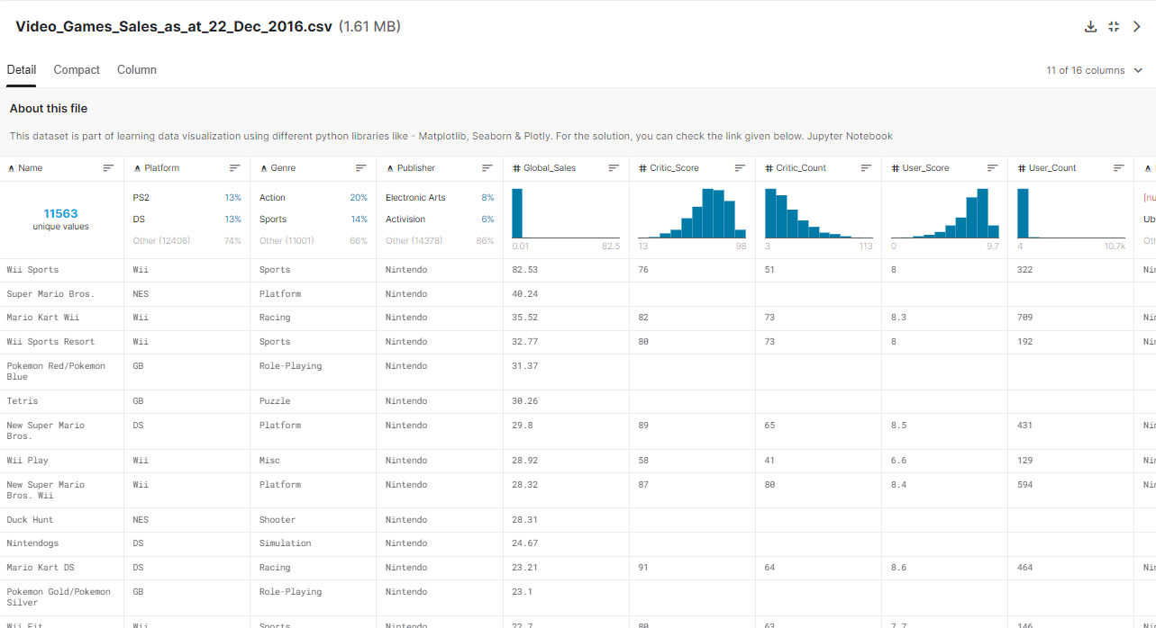
Dataset
https://www.kaggle.com/datasets/sidtwr/videogames-sales-dataset?select=Video_Games_Sales_as_at_22_Dec_2016.csv
Intro
Notes:
The dataset that we are using is the Video Games Sales as of 22 Dec 2016, which can be found on Kaggle via this link

Slide 5

Why Global Sales?
One of the main reasons why game creators create games
Good indication of success of game
Useful Variables
Genre, Publisher, Platform, Year of Release, Rating, Critic Score and User Score
Intro

Slide 6

Cleaning the dataset
NaN values
Massive Outlier
Cleaning
Notes:
Before we carried on with further EDA, we found two issues with our dataset, namely the presence of NaN values and a massive outlier. The first issue with the dataset was the presence of NaN values in different columns of data. We decided to clean the dataset by removing the rows of data that contained these NaN values.

Slide 7
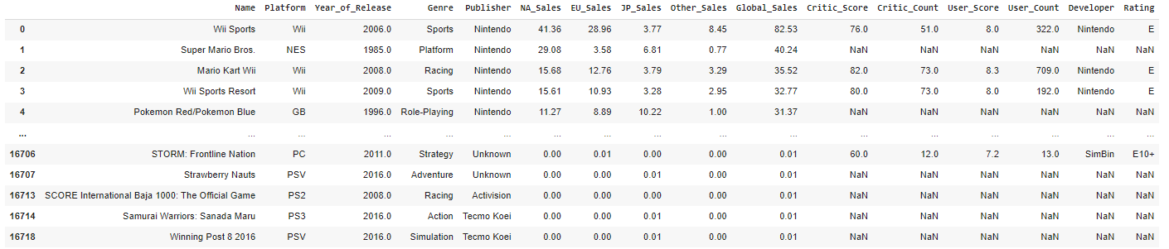
NaN values
Cleaning
Notes:
Before we carried on with further EDA, we found two issues with our dataset, namely the presence of NaN values and a massive outlier. The first issue with the dataset was the presence of NaN values in different columns of data. We decided to clean the dataset by removing the rows of data that contained these NaN values.

Slide 8
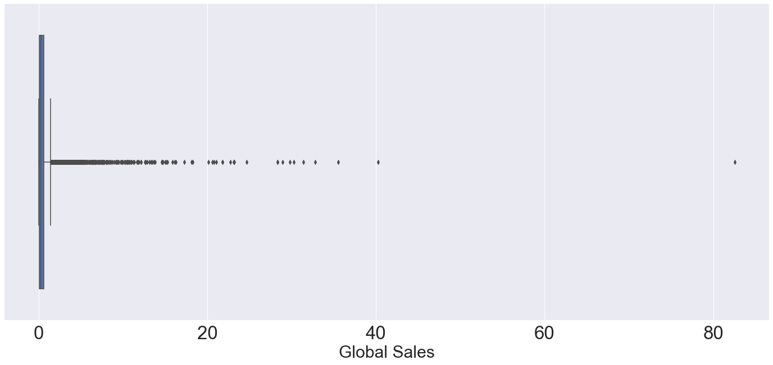
Massive Outlier
Cleaning
Notes:
Another issue that we found was the presence of a very big outlier, as shown in the boxplot above, which belonged to the data for ‘Wii Sports’. We felt that this data would greatly affect the model between the variables and Global Sales, so we removed this particular outlier. The code used is shown below.

Slide 9
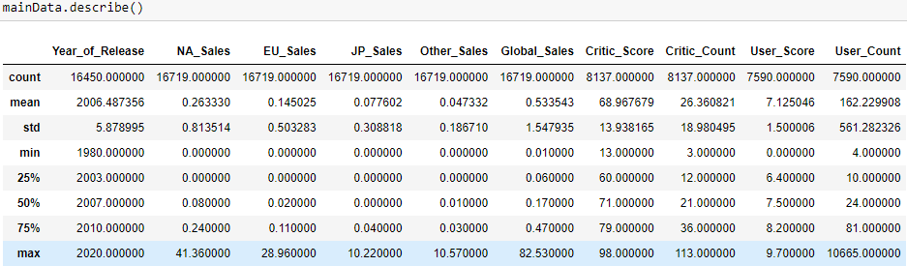
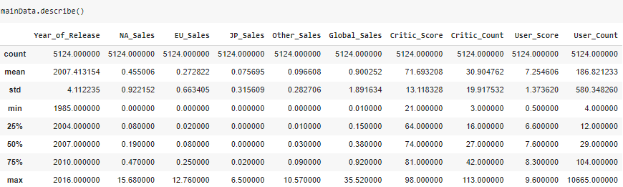
Cleaning the dataset
5124 Data
Cleaning
Notes:
After cleaning the dataset, we are left with 5124 data points, which is still sufficient for analysis.

Slide 10
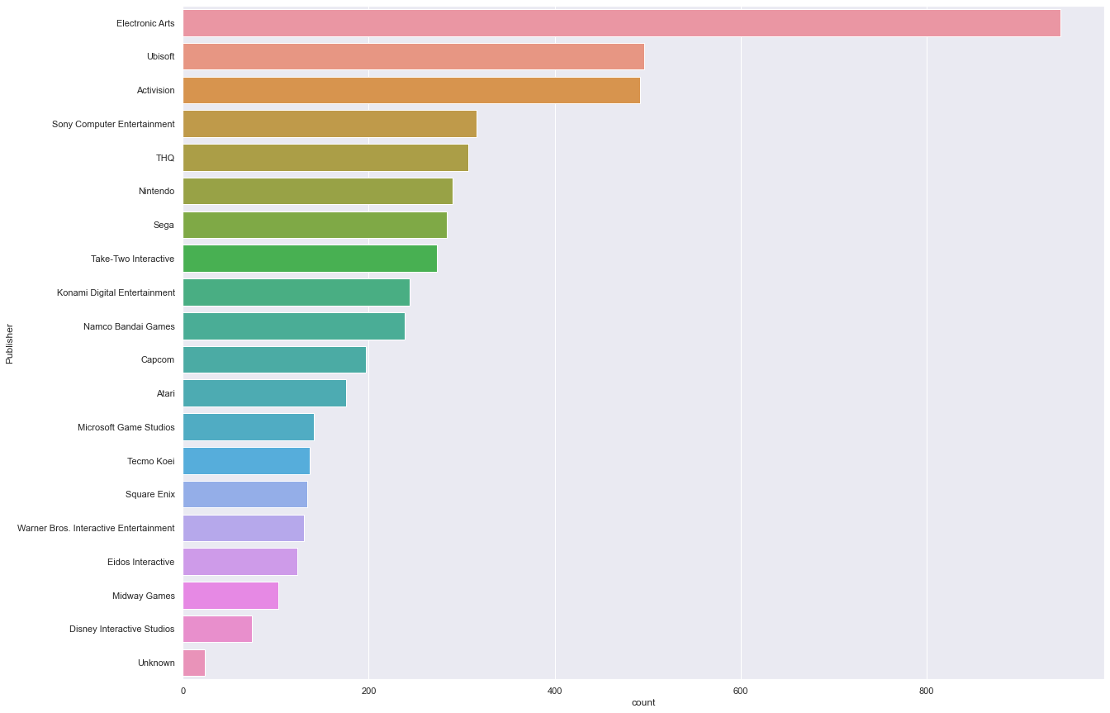
Publisher
583 Publishers
20 Publishers
EDA
Notes:
For exploratory data analysis, we begin by looking at the spread of the data. This graph shows the distribution of games by each publisher. (we chose to narrow down to the top 20 publishers as there are too many publishers included in the dataset. The publisher with the most games at that time was ‘Electronic Arts’.

Slide 11
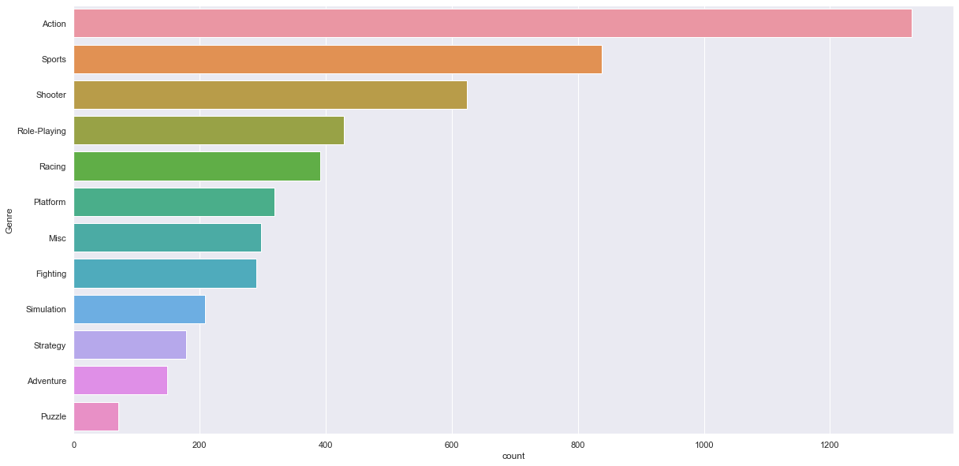
Genre
Action games are significantly more with 1330 games
EDA
Notes:
This next graph shows how many games lie in each of the genres, with ‘Action’ being the most popular genre.

Slide 12
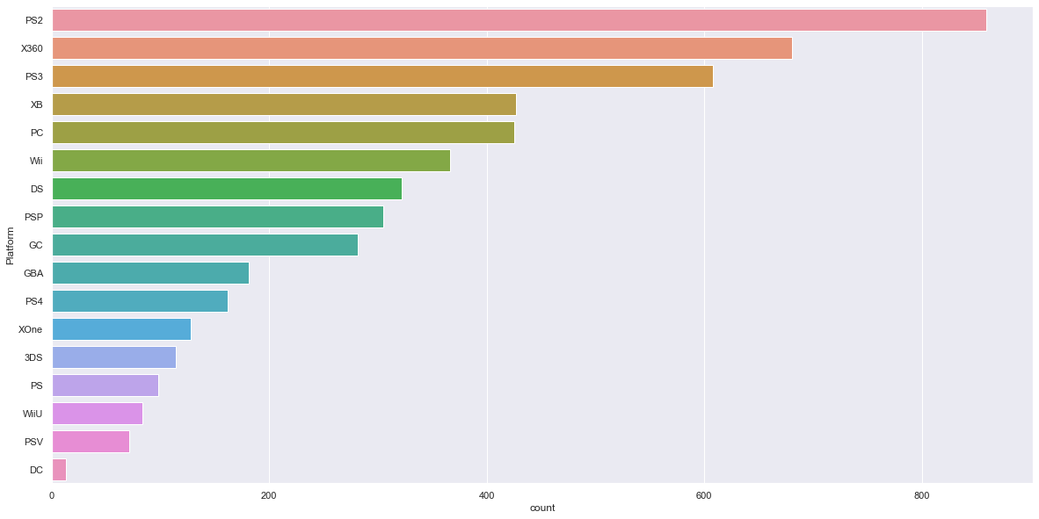
Platform Analysis
PS2
EDA
Notes:
This next graph shows how many games have been released by all platforms, with ‘PS2’ and DS having the most number of games at that time.

Slide 13
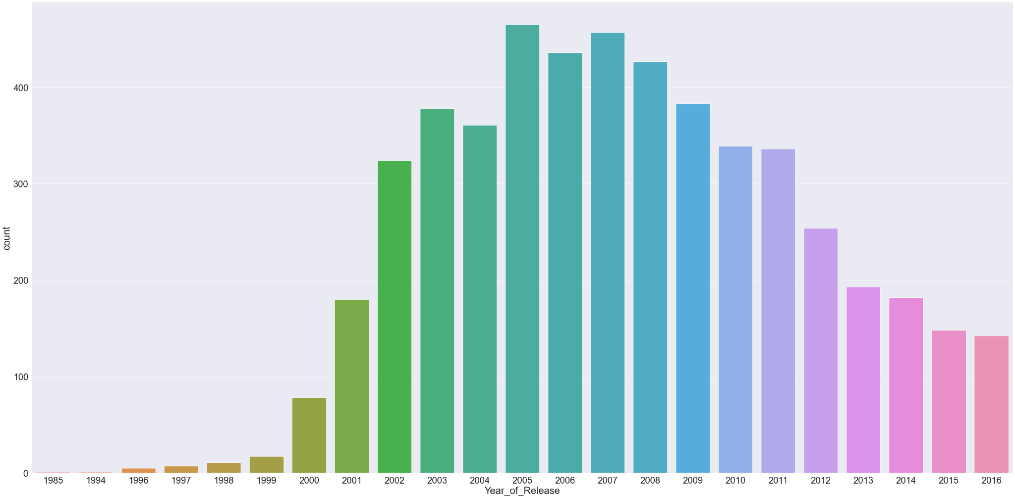
Game Year of Release
EDA
Notes:
Finally graph shows the number of games released each year from 1995 to 2016, with the period from 2005 to 2007 having the most number of games released.

Slide 14
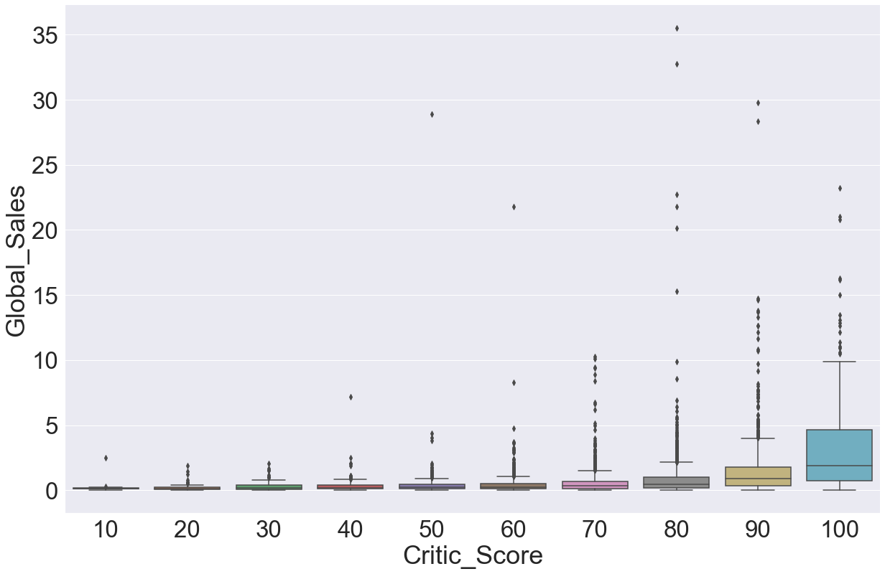
Global Sales against Critic Scores
Generally Global Sales increases when Critic Score is better
EDA
Notes:
Next, we decided to see if there were any clear relation between variables through the plotting of boxplots. This first graph shows Global_Sales against Critic Score. There seems to be a positive correlation between Critic Score and Global Sales, as seen from the rising trend shown above.

Slide 15
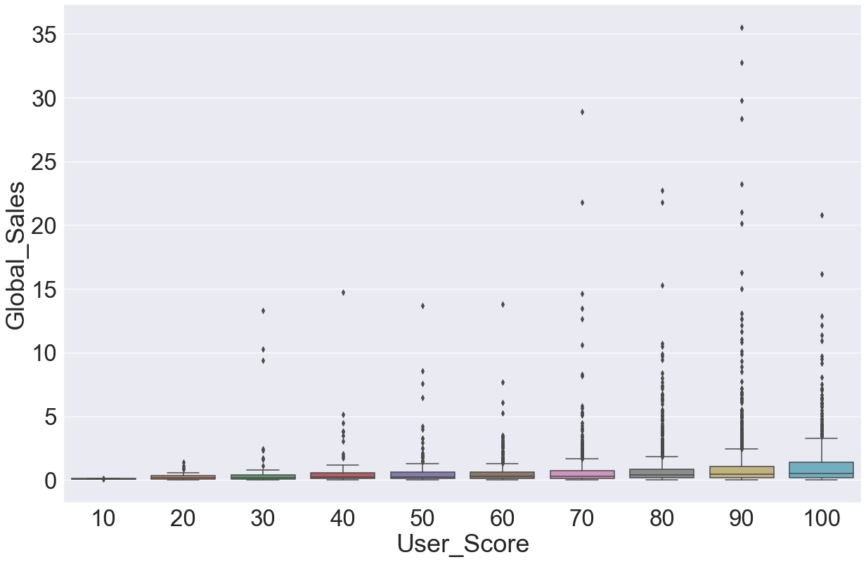
Global Sales against User Score
No obvious relation between Global Sales and User Score
EDA
Notes:
This graph plots Global Sales against User Score. There seems to be a slight positive correlation between User Score and Global Sales, with the User Score 2.6 being an outlier with the highest median.

Slide 16
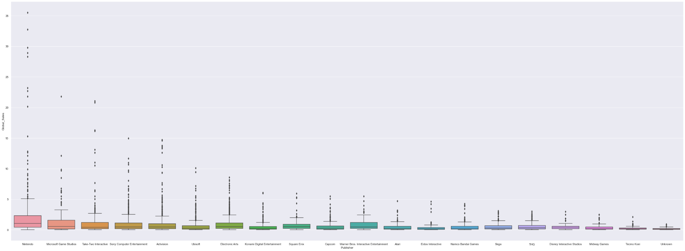
Global Sales against Publishers
Nintendo
EDA
Notes:
This graph shows Global_Sales against Publishers, with Nintendo having the highest maximum.

Slide 17
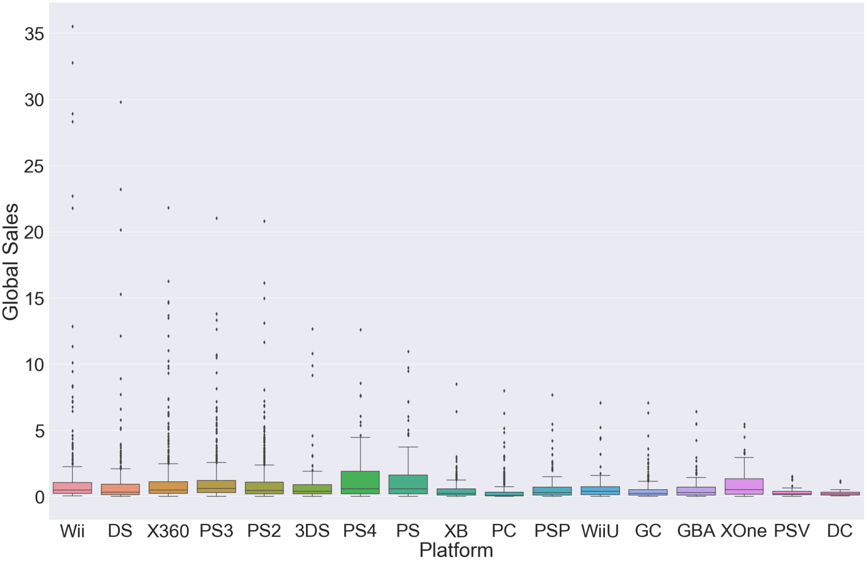
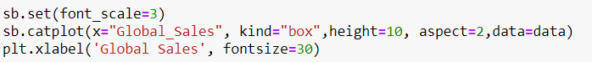
Global Sales against Platforms
EDA
Notes:
This graph shows Global_Sales against Platforms, with Wii having the highest maximum.

Slide 18
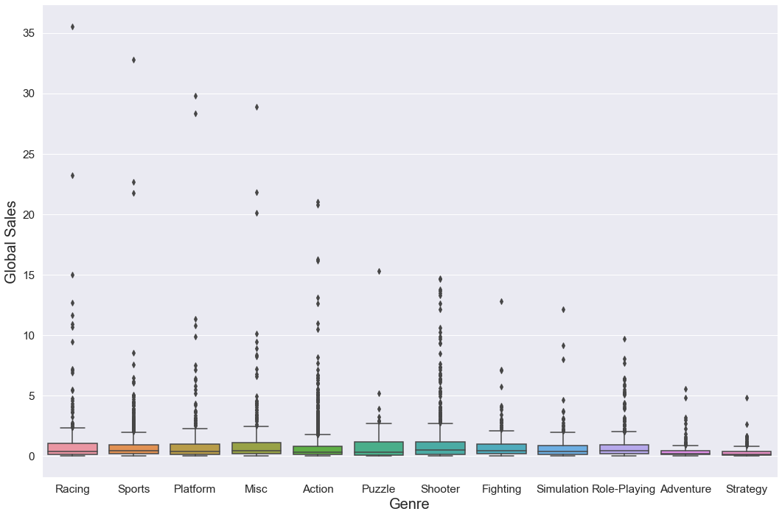

Global Sales against Genre
EDA
Notes:
This graph shows Global_Sales against Genre, where Racing has the highest maximum.

Slide 19
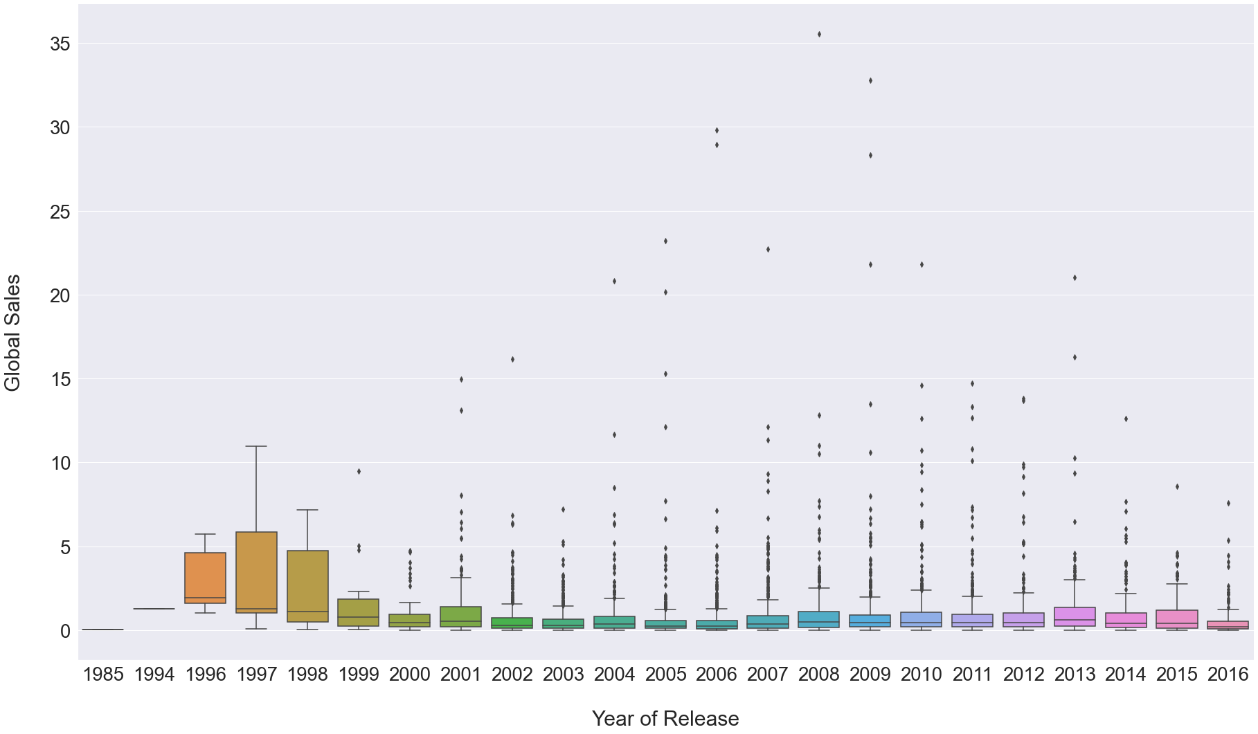


Global Sales against Year of Release
EDA
Notes:
This graph shows Global_Sales against Year of Release, where the games released before the year 2001 generally did not achieve Global Sales of more than 10 million/

Slide 20
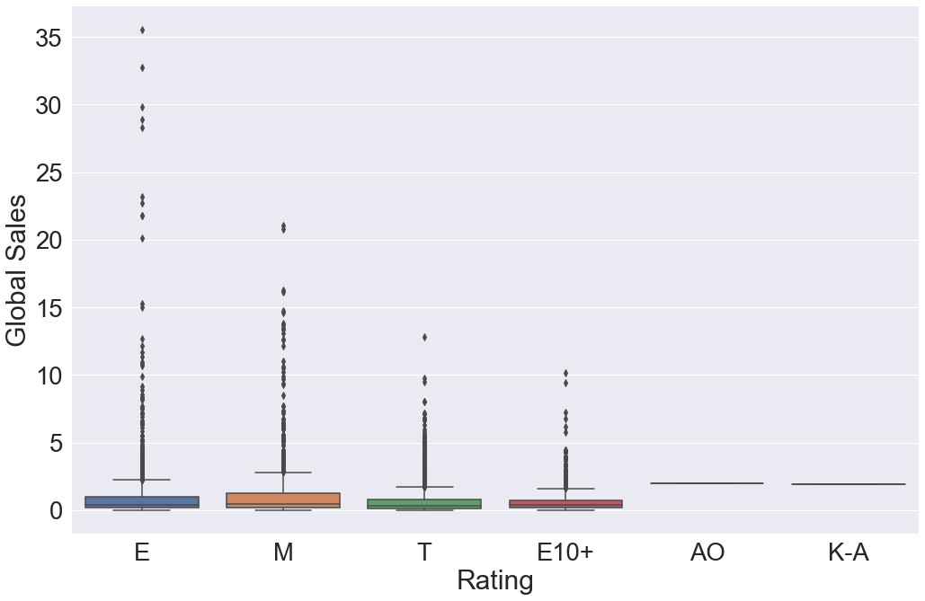

Global Sales against Ratings
EDA
Notes:
This graph shows Global_Sales against Rating, with Rating E having the most number of data points.

Slide 21
Machine Learning
Notes:
Now, we will moving onto the main portion of the project, which is Machine Learning.

Slide 22
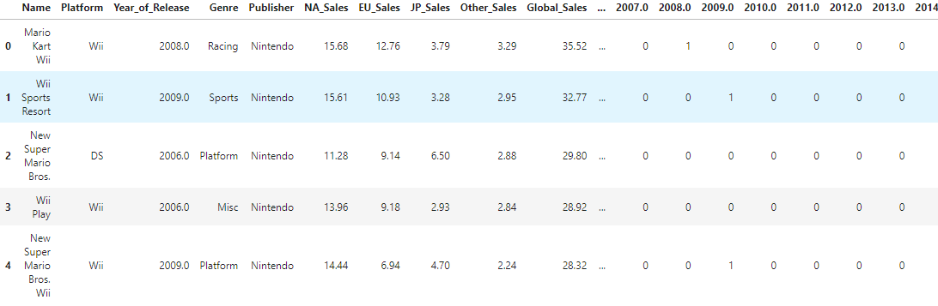
Changing categorical variables to one-hot values
Data Prep
Notes:
In order for us to do regression analysis on categorical variables, we had to convert the categorical variables to one-hot values, which is done here.

Slide 23
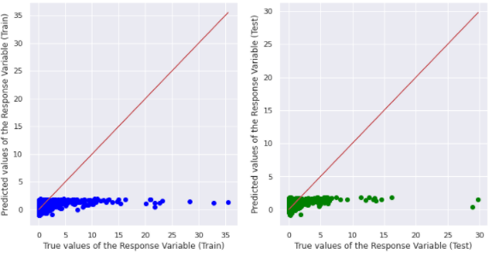
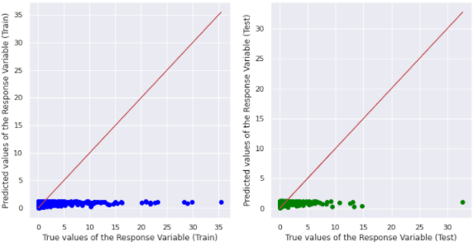
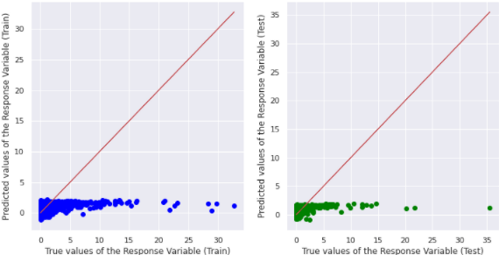
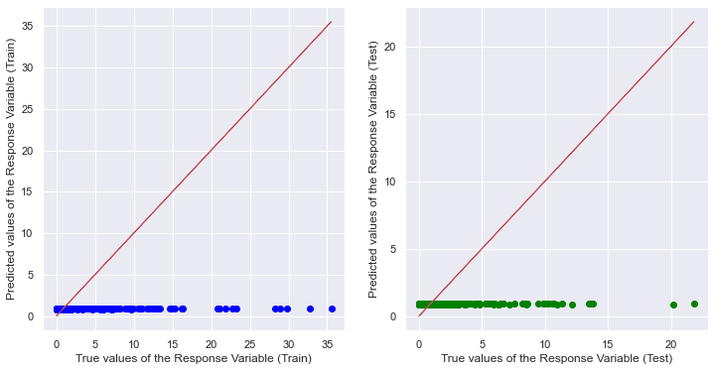
Linear Regression Analysis
Critic score against Global Sales
User score against Global sales
Critic score and User Score against Global Sales
Year of Release against Global Sales
Machine Learning

Slide 24
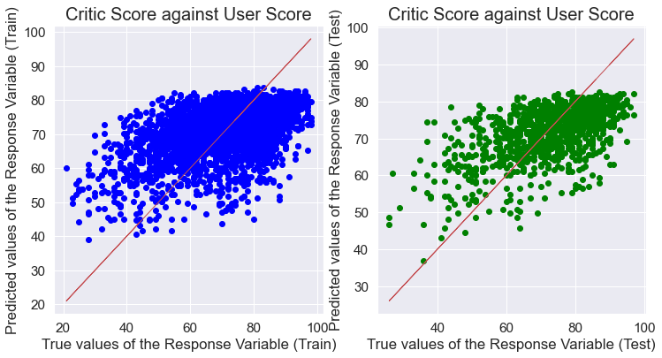
Linear Regression Analysis
Machine Learning

Slide 25
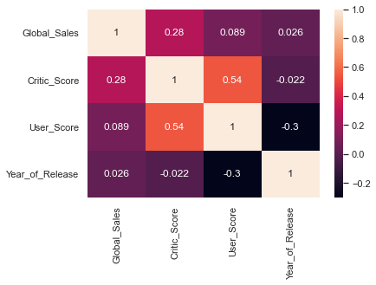
Linear Regression Analysis
Machine Learning

Slide 26
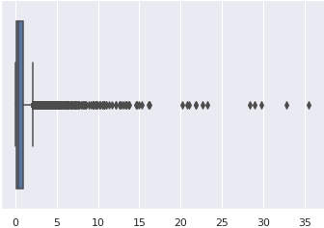
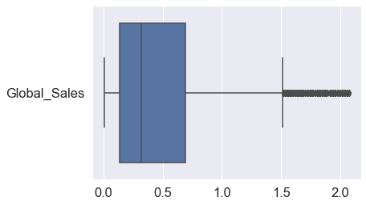
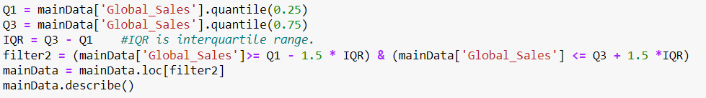
Outlier Removal
Cleaning

Slide 27
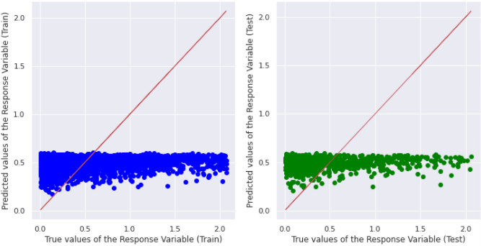
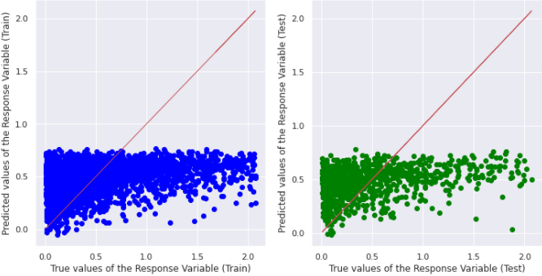
Linear Regression Analysis
User Score against Global Sales Critic Score against Global Sales
Machine Learning

Slide 28
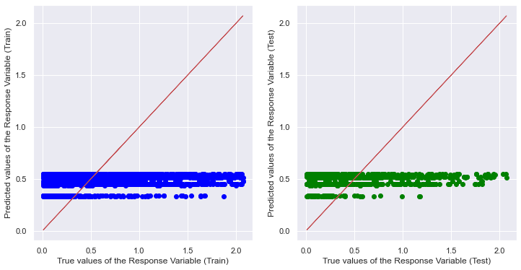
Linear Regression Analysis
Genre against Global Sales
Machine Learning

Slide 29
Random Forest
Non-linear regression
Supervised learning algorithm that consists of a lot of decision trees that help to output the mean of prediction of the individual trees
Machine Learning

Slide 30
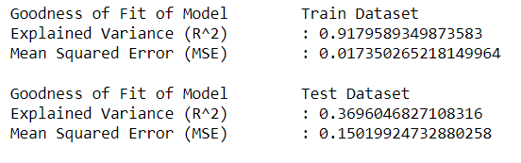
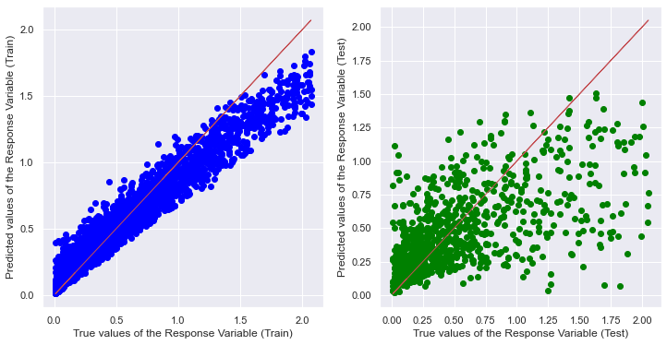
Random Forest
Accuray of train is 0.92 but test is 0.37
Overfitting of data
Machine Learning

Slide 31
Improving the model
Overfitting
Calibrate the model
Regularization
Machine Learning

Slide 32
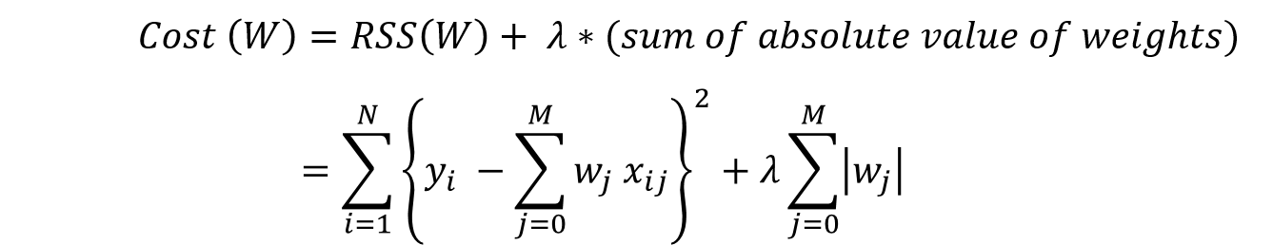
Lasso Regression
Least Absolute Shrinkage and Selection Operator
Objective = RSS + α * (sum of absolute value of coefficients)
Adds a penalty proportional to the absolute value of the magnitude of coefficients
Machine Learning

Slide 33
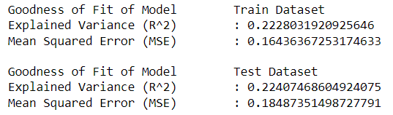
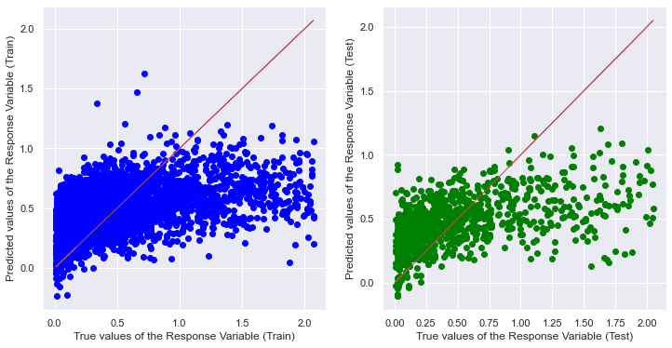
After using Lasso Regression
Accuray of train is 0.22 and test is 0.22
No overfitting of data but both accuracy are low
Machine Learning

Slide 34
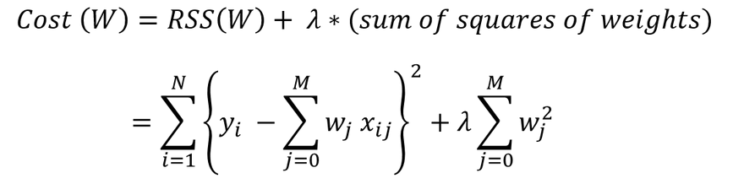
Ridge Regression
Objective = RSS + α * (sum of square of coefficients)
Adds a penalty proportional to the square of the magnitude of coefficients
Machine Learning

Slide 35
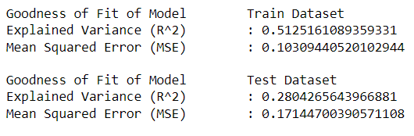
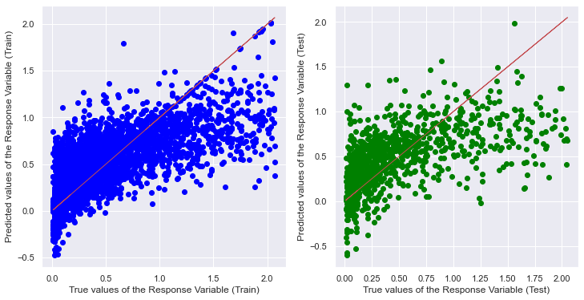
After using Ridge Regression
Accuray of train is 0.51 but test is 0.28
No overfitting of data and better accuracy
than lasso regression
Machine Learning

Slide 36
What variables affect Global Sales?
Genre
Publisher
Rating
Platform
Simulation: 0.10432
Misc: 0.09282
Shooter: 0.02152
Action: 0.01347
Fighting: 0.00261
Racing: -0.00111
Role-Playing: -0.00335
Sports: -0.09871
Adventure: -0.12221
Strategy: -0.13098
Puzzle: -0.16437
Nintendo: 0.42431
Electronic Arts: 0.19804
Square Enix: 0.14368
Ubisoft: 0.12477
Microsoft Game Studios: 0.11395
Namco Bandai Games: 0.06327
Activision: 0.04821
Sega: 0.02691
Eidos Interactive: 0.02415
Warner Bros. Interactive
Entertainment: 0.00709
THQ: -0.03221
Capcom: -0.03658
Take-Two Interactive: -0.09876
Atari: -0.15277
Disney Interactive Studios: -0.33007
AO: 0.8981
K-A: 0.35146
E: -0.27362
E10+: -0.30953
M: -0.31263
T: -0.35378
PS2: 0.26409
Wii: 0.20179
PS3: 0.14547
XOne: 0.13581
DS: 0.12716
PSP: 0.10912
PS: 0.07648
GBA: 0.06123
PS4: 0.04214
X360: 0.0091
GC: -0.03342
XB: -0.03574
3DS: -0.07862
PSV: -0.14898
WiiU: -0.15595
DC: -0.34689
PC: -0.37277
Machine Learning

Slide 37

Conclusion Insights
Simulation game - This genre showed the highest correlation to global sales
Nintendo - Publishing a game through Nintendo would generate highest global sales as Nintendo is one of the popular companies
AO rating (‘Adults-only 18+’) - Creating a game with this rating would most likely have higher global sales. People might like games with gore in it
Creating a game that is played Wii or PS2 platform will generate highest global sales - Wii and PlayStation are one of the more popular gaming platforms people use
Conclusion

Slide 38
What we learnt
Random Forest Regression
Regularisation:
Lasso Regression
Ridge Regression
Outcome of Project:
Using our Ridge Regression model, game creators can:
Choose a genre of game to create and the platform of the game
Choose which company to partner with to generate the most revenue
Conclusion

Slide 39
THANK YOU

